Slide 1
TITLE: PYTHON PROGRAMMING TASKS
LOGIC & IMPLEMENTATION

Slide 2
Topics
GST Calculator

Slide 3
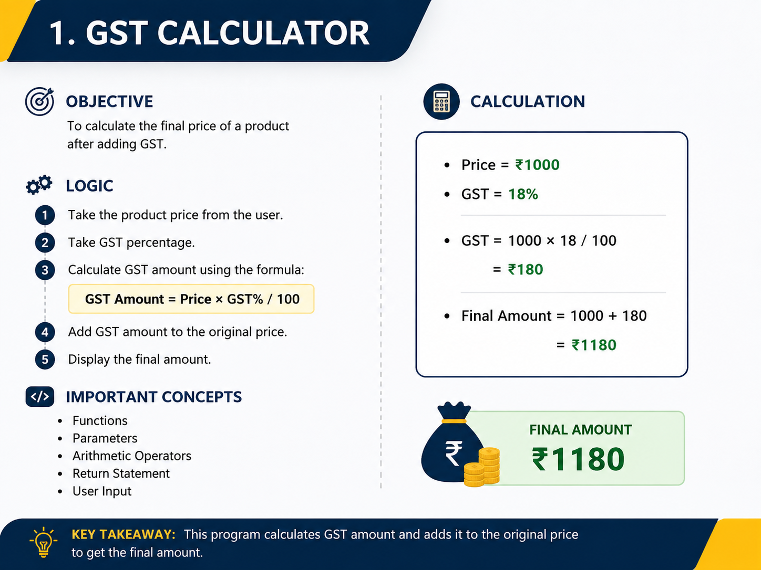

Slide 4
1. GST Calculator
Price = ₹1000
GST = 18%
GST = 1000 × 18 / 100
= ₹180
Final Amount = 1000 + 180
= ₹1180

Slide 5
2. BMI Calculator
Input Weight
↓
Input Height
↓
Convert cm → meter
↓
BMI = weight / height²
↓
Check BMI range
↓
Display BMI + Category
BMI | Category
< 18.5 | Underweight
18.5 – <25 | Normal weight
25 – <30 | Overweight
30+ | Obese

Slide 6
3. Employee ID Generator
Create Employee class
↓
Store company name
↓
Maintain employee count
↓
Create employee object
↓
Increase employee count
↓
Generate ID
↓
Display employee details

Slide 7
4. Plane Inheritance
Plane
/ | \
/ | \
CargoPlane Passenger Fighter

Slide 8
Bank Transaction Analyzer
Transactions
↓
Separate Credits
↓
Separate Debits
↓
Apply 10% Cashback
↓
Calculate Balance
↓
Display Report

Slide 9
Visitor Management System
Manage Class
│
├── checkIn()
│
├── checkOut()
│
├── guidelines()
│
└── exit()
Enter Entry Time
↓
Is 0–23?
↙ ↘
YES NO
↓ ↓
Accept Error

Slide 10
String Slicing & Formatting
Syntax | Meaning
s[:5] | First 5 characters
s[-4:] | Last 4 characters
s[2:8] | Characters from index 2 to 7
s[::2] | Every second character
s[::3] | Every third character
s[::-1] | Reverse string

